Slide 1
Software Engineering
Lecture 3 – Requirements Engineering Processes

Slide 2
Objectives
To describe the principal requirements engineering activities and their relationships
To introduce techniques for requirements elicitation and analysis
To describe requirements validation and the role of requirements reviews
To discuss the role of requirements management in support of other requirements engineering processes

Slide 3
Requirements Engineering Processes
The processes used for requirements engineering vary widely depending on the application domain, the people involved and the organisation developing the requirements.
However, there are a number of generic activities common to all processes which we look at today.
The goal of this stage of the software engineering process is to help create and maintain a system requirements document.

Slide 4
The Requirements Engineering Process

Slide 5
Requirements Engineering Processes
1. Requirements elicitation;
What services do the end-users require of the system?
2. Requirements analysis;
How do we classify, prioritise and negotiate requirements?
3. Requirements validation;
Does the proposed system do what the users require?
4. Requirements management.
How do we manage the (sometimes inevitable) changes to the requirements document?

Slide 6
Example
Patient records system
(Elicitation) 1. Talk to patients, doctors, nurses, receptionists, managers to find out
Current system practise, legal restrictions DPA, problems with current system, needs for improvement, security issues, costs
(Elicitation) 2. Develop draft documentation and review what is most important, what will it cost, what is the timescale, is new hardware required
(Validation) 3. Send requirements to end users. Present them with Q&A. Go back to step 1, discuss requirements again
(Management) 4. Have a yearly review of requirements between all stakeholders. Have a system of reviewing the cost and feasability of change to system

Slide 7
Feasibility Study Implementation
Based on information assessment (what is required), information collection and report writing.
Questions for people in the organisation
What if the system wasn’t implemented?
What are current process problems?
How will the proposed system help?
What facilities must be supported by the proposed system?

Slide 8
Elicitation and Analysis
Sometimes called requirements elicitation or requirements discovery.
Involves technical staff working with customers to find out about the application domain, the services that the system should provide and the system’s operational constraints.
May involve end-users, managers, engineers involved in maintenance, domain experts, trade unions, etc. These are called stakeholders.

Slide 9
Problems of Requirements Analysis
Stakeholders don’t know what they really want.
Stakeholders express requirements in their own terms.
Different stakeholders may have conflicting requirements
Example, staff → easy of use, management → highest security
Patients → change appointments easily, management → plan staff resourcing, reduce costs
Organisational and political factors may influence the system requirements (Data protection)
The requirements change during the analysis process. New stakeholders may emerge and the business environment change.

Slide 10
Requirements Discovery
Requirements discovery is the process of gathering information about the proposed and existing systems and distilling the user and system requirements from this information.
Sources of information include documentation, system stakeholders and the specifications of similar systems

Slide 11
What is an SRS Document?
SRS stands for Software Requirements Specification. It is a formal document that describes:
What the software will do.
How it will perform.
Constraints, interfaces, and requirements.
It acts as a bridge between the client and development team to ensure both understand the software expectations clearly.

Slide 12
An SRS document typically includes the following sections
An SRS document typically includes the following sections:
1. Introduction
Purpose of the software,Scope,Definitions, acronyms, abbreviations,References.
2. Overall Description
Product functions (summary).,User characteristics,Constraints (e.g., legal, hardware limitations).
Assumptions and dependencies.
3. Specific Requirements
Functional Requirements: What the system should do.
Non-functional Requirements:
Performance
Security
Usability
Reliability
External Interfaces:User interfaces,Hardware interfaces,Software interfaces,Communication interfaces
4. Appendices
Supporting info: diagrams, glossary, formulas.

Slide 13
EXAMPLE
Introduction
Purpose: To automate student registration, attendance, and marks.
Scope: Web-based system for managing student-related data.
Definitions:
Admin: The person who controls the system.
Student: End user of the system.
References: IEEE SRS standard.

Slide 14
Overall Description
Product Perspective: A standalone web application.
Product Functions:
Student registration and login.
Attendance management.
Mark entry and report generation.
User Characteristics:
Admin: computer knowledge.
Students: Basic computer knowledge
Constraints:
Must run on any modern browser.
Assumptions:
Users have internet access.

Slide 15
Specific Requirements
Functional Requirements:
FR1: The system shall allow students to register.
FR2: The system shall allow the admin to enter marks.
FR3: The system shall generate attendance reports.
Non-functional Requirements:
NFR1: The system should respond within 3 seconds.
NFR2: Passwords must be encrypted.
NFR3: The system should be usable on mobile and desktop.

Slide 16
External Interfaces:
UI: Web-based form for registration.
Software: MySQL Database backend.
Hardware: Desktop/laptop or smartphone.
Communication: HTTP over TCP/IP.
Appendices
ER Diagram
Glossary
Sample Screenshots

Slide 17
REQUIREMENTS DOCUMENTS
Use Case | User Story
Used to define functional requirements in detail |  | Used to capture high-level user needs and features

Slide 18
Use Cases
Use-Cases are a scenario based technique in the Unified Modeling Language (UML) which identify the actors in an interaction and which describe the interaction itself.
A set of use-cases should describe all possible interactions with the system.
Supports communication between clients and developers.

Slide 19
Use Cases
In a use-case diagram, an actor is a user of the system (i.e. Something external to the system; can be human or non-human) acting in a particular role.
A use-case is a task which the actor needs to perform with the help of the system, e.g., find details of a book or print a copy of a receipt in a bookshop.

Slide 20
Use Cases
The details of each use case should also be documented by a use case description: E.g.,
Print receipt – A customer has paid for an item via a valid payment method. The till should print a receipt indicating the current date and time, the price, the payment type and the member of staff who dealt with the sale.
[Alternate Case] – No print paper available – Print out “Please enter new till paper” to the cashier’s terminal. Try to print again after 10 seconds.
An alternate case here is something that could potentially go wrong and denotes a different course of action.

Slide 21
Example - Article Printing Use-Case
Actor
Use case

Slide 22
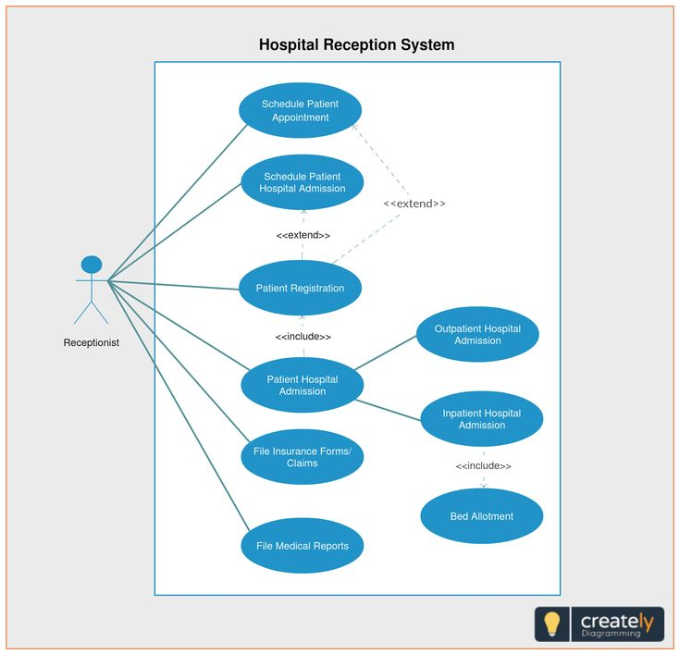

Slide 23
ATM machine
Actors
Customers
Bank staff
ATM service engineer
Use cases
Withdraw cash
Check balance
Add cash to machine
Check security video recording

Slide 24
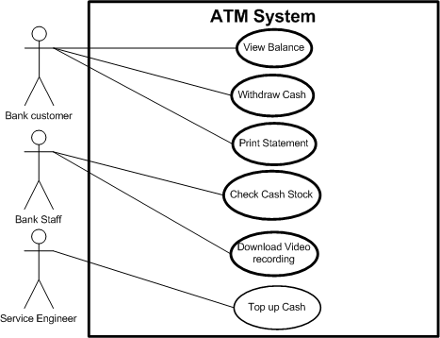
Example - ATM Use Case Diagram

Slide 25
Advanced Use Case Diagrams
We can draw a box (with a label) around a set of use cases to denote the system boundary, as on the previous slide (“library system”).
Inheritance can be used between actors to show that all use cases of one actor are available to the other:
Bank Staff
Customer

Slide 26
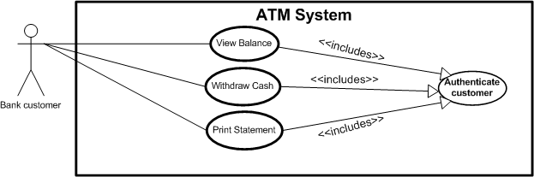
Include Relations
If several use cases include, as part of their functionality, another use case, we have a special way to show this in a use-case diagram with an <<include>> relation.

Slide 27
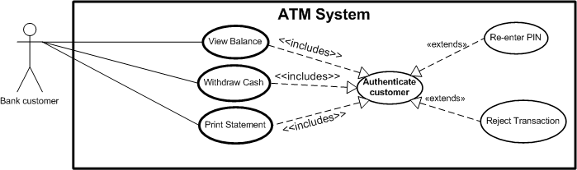
Extend Relations
If a use-case has two or more significantly different outcomes, we can show this by extending the use case to a main use case and one or more subsidiary cases.

Slide 28
In summary
Include
When the other use case is always part of the main use case
Extend
When the other use case, sometime is needed

Slide 29
A Word on Extend/Include
Note the directions of the arrows in the previous two slides, they are different for each (according to whether a use case “includes” another, or “extends” it).
One of the benefits of UML diagrams is their simplicity and that they can be shown to and worked through with, customers.
This is to some extent lost by using more advanced features like “include” and “extend” relations; they should thus be used with care.

Slide 30
Full use case template
ID
Short ID (useful for diagrams and reference)
Name
Full name
Description
Full description
Pre-condition
What must be true before the use case can proceed
Event flow
Flow of behaviour that makes up this use case
Post-condition
What should be true if the use case successfully completes
Includes
What other use cases are used
Extensions
Optional behaviour
Triggers
What makes this use case happen

Slide 31
Notes about use cases
They do NOT describe internal behaviour
Must describe behaviour with external Actors
But external Actor can be
External system (e.g. Paypal)
External hardware (e.g. smoke detector fire alarm)
External agency (e.g. Police, fire brigade)
So Use cases are always systems EXTERNAL behaviour

Slide 32
ATM use case descriptions
ID | UC1
Name | Withdraw cash
Description | Bank customer withdraws cash from machine
Pre-condition | ATM in service
Pre-condition | ATM has sufficient cash stock
Event flow | 1. Include Use case 2 “Authenticate customer” 2. Choose quick cash or enter exact amount 3. Choose receipt option 4. Take cash
Extension points | Use case 4 “Balance too low”
Triggers

Slide 33
ATM use cases
ID | UC2
Name | Authenticate customer
Description | Bank customer withdraws cash from machine
Pre-condition | ATM in service
Event flow | 1. If user already authenticated exit from user case. 2. User enters card and PIN number 3. User re-enters PIN if PIN incorrect
Extension points | Use case 5 “Card stolen” Use case 6 “PIN entry failure”
Triggers | Authenticated service requested and user not authenticated
Post-condition | User is authenticated

Slide 34
ATM use cases
ID | UC3
Name | Check balance
Description | Bank customer retrieves a balance on their account
Pre-condition | ATM in service
Event flow | 1. Include Use case 2 “Authenticate customer” 2. Choose onscreen or paper balance
Extension points | Use case 5 “Card stolen” Use case 6 “PIN entry failure”
Triggers | Authenticated service requested and user not authenticated
Post-condition

Slide 35
User stories
Component | Description | Example
1. Title | A short label for the story | User Registration
2. Role (Who) | The type of user who wants the feature | “As a new user”
3. Goal (What) | What the user wants to do | “I want to sign up for an account”
4. Reason (Why) | The reason or benefit the user gets | “so that I can access members-only content”
5. Acceptance Criteria | Conditions that define when the story is complete and correct | “Given that I enter valid details, when I click submit, I get a welcome email.”
6. Priority | Importance of the story (optional) | High / Medium / Low

Slide 36
example
Title: User Login User Story: As a registered user, I want to log into my account, so that I can access my personalized dashboard.
Acceptance Criteria:
User must be able to enter email and password
Invalid credentials must show an error message
Successful login should redirect to the dashboard

Slide 37
Requirements validation
Requirements validation in software engineering is the process of ensuring that the requirements documented in the Software Requirements Specification (SRS) accurately reflect the needs and expectations of the stakeholders. It's a critical step to identify and rectify any errors, inconsistencies, or omissions in the requirements before they lead to costly rework later in the development lifecycle.

Slide 38
Requirement reviews:- this technique involves collecting reviews after a sample of requirement documentation is given to the customer. These requirement reviews received from the customer act as feedback and help the developer to make required modifications and changes in the project.
Prototyping:- this is a way of building a model or simulation of the system that is to be built by the developers. This is a very popular technique for requirement validation among stakeholders and users, as it helps them easily identify problems, detect missing requirements and understand how techniques help them.

Slide 39
Test case regeneration:- this technique involves submitting a test case to the customer gathering reviewed information and feedback from the customer, and then developing the same test case according to the requirements specified by the customer and keeping on regenerating till a satisfactory product is obtained.
Inspection:- This technique involves reviewing the requirement documentation with a group of experts and looking for errors, inconsistencies And misinformation.
Walkthrough:- This technique involves a group of experts reviewing the requirement documentation and walking through it line by line discussing any issue or concerns that arise during the reviewing document.

Slide 40
Scenario: Online Library Management System
The client wants to develop a system where students can:
Search for books.
Borrow and return books online.
Receive reminders for due dates.
R1: The system shall allow users to borrow up to 5 books at a time.

Slide 41
Let’s validate R1 step by step:
Validation Check | Question | Outcome
Correctness | Is this requirement what the user really needs? | ✔ Yes. Students have limited borrowing capacity.
Clarity | Is the requirement clear and unambiguous? | ❌ No. What type of books? What if a user returns one—can they borrow another immediately?
Feasibility | Can this be implemented with current resources? | ✔ Yes, it can be implemented using user and book databases.
Consistency | Does it conflict with any other requirement? | ❌ Maybe. Another requirement says “Faculty can borrow unlimited books”—needs clarification.
Verifiability (Testability) | Can we test this requirement? | ✔ Yes. We can write a test case to check if a user is blocked after 5 borrowings.
Completeness | Are all necessary details included? | ❌ No. What happens when a user reaches the limit? Is there a waiting period?

Slide 42
Improved clarity: No confusion about who the rule applies to.
No contradiction: Faculty's unlimited borrowing is now clearly stated.
Testable: A developer/tester can create a test to validate this limit.

Slide 43
Lecture Key Points
The requirements engineering process includes a feasibility study, requirements elicitation and analysis, requirements specification and requirements management.
The requirements elicitation and analysis stage is iterative and involves domain understanding, requirements collection, classification, structuring, prioritisation and validation.
Systems have multiple stakeholders with different requirements
Security for most systems is a core service

Slide 44
Expected questions SHORT ANSWER TYPE QUESTIONS
What are the components of the use case diagram.
discuss the structure of SRS document.
use case diagram for hospital management system.
what the components of the use case diagram.
syntax of user stories.
components of user stories with examples.
use case diagram for a library management system.
LONG ANSWER TYPE QUESTIONS
principal requirements engineering process activities.
SRS Document
What is requirements elicitation and analysis.
requirements elicitation considered as a critical task in requirements engineering justify
methods for requirements elicitation. Explain the validation phase in requirements engineering process

